Slide 1








Franchise Partnership Program
Nourishing Lives, One Meal at a Time • High-Margin, Affordable Regional Indian Thalis, Unlimited Meals, Daily Tiffins & Event Catering

Slide 2

The Indian Food Revolution
Unlocking the immense Philippine appetite for flavorful, unlimited, and affordable dining through standardized regional Indian cuisine.

Slide 3


Market Gap & Our Disruption
The Philippine Market Void
The Simhika Solution
Overpriced Fine Dining: Existing Indian restaurants in BGC, Makati, and Ortigas charge ₱600–₱1,200 per dish, locking out mainstream Filipino diners.
The ₱199 Price Revolution: Complete 4-dish combo thalis from ₱180–₱220, matching regular food court budgets with unmatched exotic flavor.
Lack of Quick Combos: BPO professionals, students, and office workers have no access to fast, affordable, pre-portioned ethnic lunch trays.
Filipino Cultural Synergy: Capitalizing on the country's passion for "Unli-Rice & Gravy," driving massive lunch hour queues.
4 Resilient Cash Streams: Seamlessly integrating dine-in foot traffic with recurring monthly tiffins and high-margin event catering.
Inconsistent Street Options: Rare budget Indian stalls suffer from inconsistent hygiene, poor packaging, and unstable ingredient supply.

Slide 4

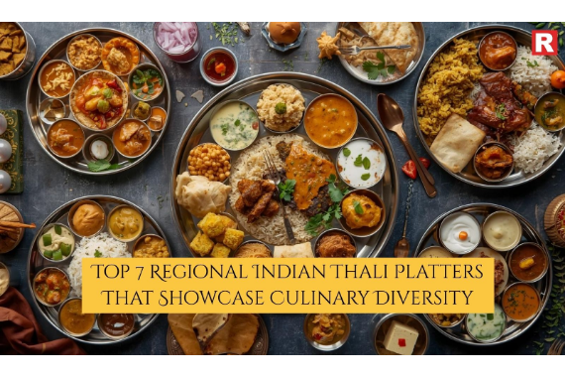
Authentic Regional Indian Thalis
Simhika Kitchen brings the diverse regional culinary traditions of India into standardized, high-velocity commercial kitchen sets:
•
North Indian Royal Thalis: Rich Dal Makhani, Paneer Butter Masala, aromatic Jeera Basmati, and hot tandoor rotis.
•
South Indian Coastal Feasts: Tangy Sambar, pepper Rasam, fresh vegetable Poriyal, crisp papad, and refreshing curd rice.
•
Gujarati & Western Platters: Mild sweet-savory gravies, yellow dal, dry spiced subzi, and fresh homestyle phulkas.
•
Healthy Homestyle Commitment: 100% whole spices, zero chemical food colorings, low cooking oil, and uncompromised authentic flavor.

Slide 5






The "Unlimited Meals" Advantage
The Unli-Rice Culture
Sub-30% Food Cost
Viral Word-of-Mouth
Filipino diners love unlimited meal formats (pioneered by Mang Inasal). Simhika applies this winning formula to fragrant Basmati rice and rich Indian gravies.
Rice, dals, and base gravies carry extremely low raw ingredient costs. Unlimited refills delight diners while preserving hefty 68%+ gross profit margins.
Unlimited authentic Indian meals starting at just ₱299 generate intense TikTok and Facebook virality, creating packed restaurants with zero ad spend.

Slide 6







Four High-Margin Revenue Streams
Dine-In & Express Thalis
Monthly Office Tiffins
Corporate & Party Catering
Delivery App Domination
High-turnover daily counter sales and sit-down dining sets engineered for ultra-fast table turnaround during lunch rushes.
Prepaid 20-day weekday lunch subscriptions delivering hot, healthy home-style food directly to BPO and expat towers.
Bulk event orders for embassy functions, corporate townhalls, Diwali galas, weddings, and Filipino family celebrations.
Optimized GrabFood & Foodpanda combo listings driving steady off-peak and late-night cloud kitchen revenue.

Slide 7
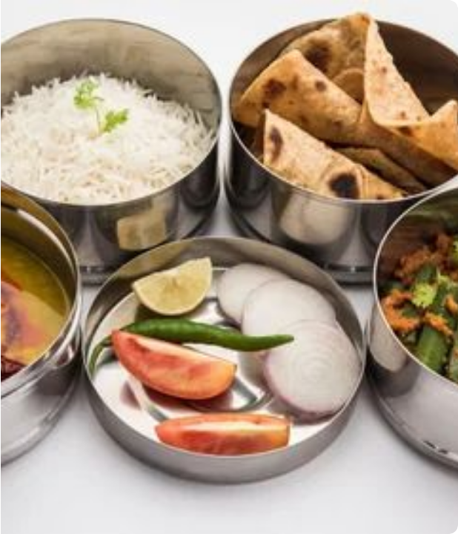
Corporate Tiffins & Catering
Guaranteed Prepaid Cash Flow
Our subscription tiffin model secures 100% upfront monthly cash payments before a single meal is prepared. Pre-scheduled delivery routes allow central kitchens to batch-cook with zero ingredient wastage.
Corporate events and embassy catering packages yield 50%+ net margins with zero front-of-house overhead.

Slide 8
Franchise Investment Models
Model Format | Capital Outlay | Target Monthly Sales | Projected ROI | Core Operational Focus
1. Cloud Kitchen Setup | ₱500,000 | ₱200,000+ | 30% per annum | Low-rent commissary; BPO tiffin boxes, GrabFood, and Foodpanda delivery.
2. Mall Takeout Kiosk | ₱1,000,000 | ₱500,000+ | 20% – 30% per annum | High-traffic mall food courts; rapid grab-and-go express mini thali combos.
3. Full Restaurant Setup | ₱1,500,000 | ₱1,000,000+ | 25% per annum | Full experiential dining; unlimited thali feasts, family banquets, and bulk catering.

Slide 9
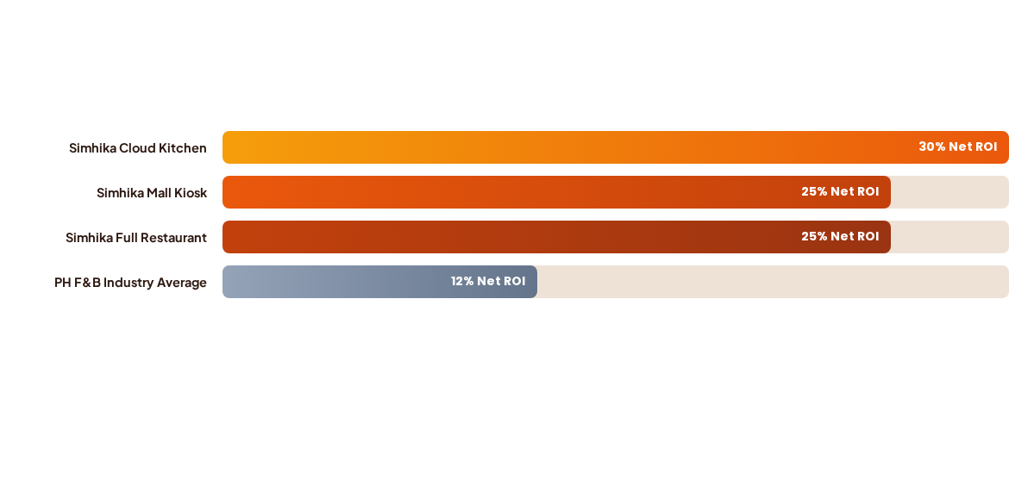
Projected Annual Net Returns
Simhika Kitchen's standardized base gravies, prepaid tiffin subscriptions, and optimized food cost ensure franchise payback within 14 to 18 months—more than double the industry average.

Slide 10


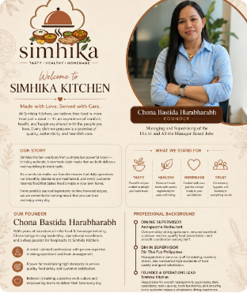

Founder & Operations Lead
World-Class Restaurant & Operations Mastery
Combining decades of international hospitality standards with local Philippine restaurant execution:
•
Dining Supervisor at Annapoorna Restaurant: Directed front-of-house dining service, floor coordination, presentation aesthetics, and authentic guest hospitality.
•
Dine-In Supervisor at Din Tai Fung Philippines: Managed high-volume shift scheduling, strict inventory controls, and Michelin-level standards of speed, hygiene, and cleanliness.
•
Founder & Operations Lead at Simhika Kitchen: Directly supervises unit-level operational audits, onboarding SOPs, and service excellence across all branches.
"Made with Love. Served with Care. We believe food is an experience of comfort, health, and genuine happiness shared with the people you love."
Chona Bastida Harabharabh
FOUNDER & OPERATIONS LEAD

Slide 11

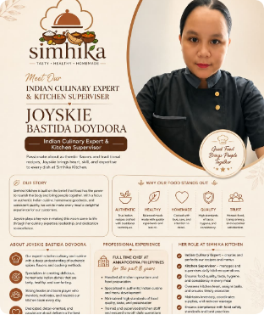

Indian Culinary Master Chef
8+ Years Master Indian Kitchen Authority
The culinary mastermind behind Simhika Kitchen's standardized spice blends and signature regional thalis:
•
Full-Time Chef at Annapoorna Philippines (Past 8 Years): Led high-capacity commercial kitchen brigades, traditional masala grinding, and regional curry operations.
•
Proprietary Base Gravy System: Developed plug-and-play mother gravies that allow non-Indian kitchen staff to recreate 100% authentic flavors consistently without hiring master chefs.
•
Quality, Hygiene & Waste Elimination: Enforces zero-waste batch cooking, stringent portion standards, and strict food safety protocols to protect franchisee margins.
"Good Food Brings People Together. We craft authentic Indian dishes with healthy ingredients, less oil, and uncompromised home-style integrity."
Joyskie Bastida Doydora
INDIAN CULINARY EXPERT & KITCHEN SUPERVISOR

Slide 12
Comprehensive Partner Support
Zero-Chef Dependency (Plug-and-Play Gravies): Standardized mother gravies and pre-measured spice kits ensure perfect authentic taste with standard local line cooks.
Direct Wholesale Supply Chain: Access bulk wholesale pricing for Basmati rice, Indian whole spices, lentils, and custom eco-friendly takeaway thali packaging.
Aggregator & Digital Marketing Launch: Complete setup on GrabFood, Foodpanda, and Google Maps, supported by targeted localized social media marketing.
Intensive 14-Day Staff Bootcamp: Full operational training covering quick portion assembly, hygiene protocols, POS management, and customer care.

Slide 13
Invest Today. Earn Tomorrow.
Be a Part of the Simhika Kitchen Family and Build Your Profitable Future!
Join the pioneer of affordable, authentic Indian dining in the Philippines. Together, let's bring healthy, delicious, and unlimited thalis to millions of Filipino diners and professionals.
franchise@simhikakitchen.ph
Inquire via WhatsApp / Mobile
Metro Manila, Philippines

Slide 14


Image Sources
https://restaurantindia.s3.ap-south-1.amazonaws.com/s3fs-public/2025-09/Top%207%20Regional%20Indian%20Thali%20Platters%20That%20Showcase%20Culinary%20Diversity.jpg
Source: www.restaurantindia.in
https://5.imimg.com/data5/SELLER/Default/2025/11/562387345/YO/PZ/WW/188425901/food-tiffin-catering-services-500x500.jpg
Source: www.indiamart.com

